Slide 1
User Story Mapping
From current state to planning work

Slide 2
What is it?
A collaborative exercise to promote discussion between stakeholders;
A way to see each activity and story in its context;
A way to build a shared understanding of own the product will be used;

Slide 3
How to do it?
Imagine how the work is done today
Tell the story from start to finish
Build the map
Write the story, one step at a time
Organize it
Explore alternative
Create the story backbone
Group the task into specific objective to meet (a release)
It is not a straight line!

Slide 4
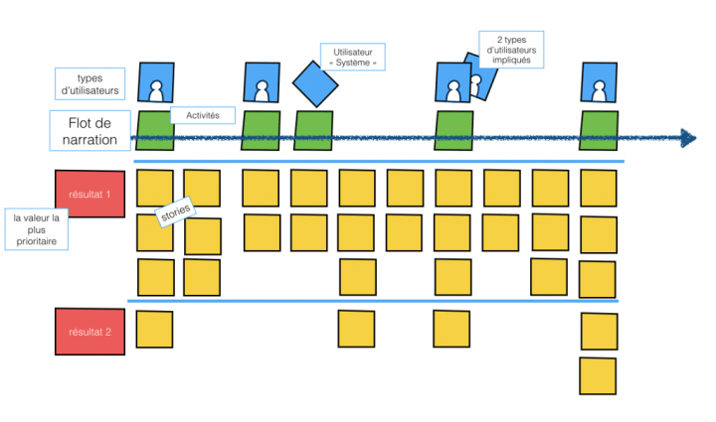
Parts of the Story Mapping
http://www.berejeb.com/2016/02/construisez-votre-user-story-map-en-5-etapes-faciles-une-autre-facon-de-representer-le-backlog-de-produit/

Slide 5
Exercise – write the story
The goal is to get the feeling of what it is like to build a story map
Take 2 minutes to think about what you’ve done this morning from the moment you woke to when you left for work.

Slide 6
Exercise (cont’d) – write the story
What was the first thing?
Write down the first few thing you remember (one per post-it ;-).

Slide 7
Exercise (cont’d) – organize it
We just started to tell the story
Now organize it.
What are the activity that those tasks exist for?
Who’s doing it / responsible for it?
Could it be someone else?
Could we think of the “who” as a role instead of as an individual?
5 minutes

Slide 8
Exercise (cont’d) – organize it (iterate)
Have you come up with the same activity in the same order?
If not why?
If everything is the same among everybody, do you understand it the same way?
Is there anything missing?
This is an opportunity to recognize missing things and fill the gap.
Look at the different way to describe those tasks
Are they all at the same level? Task or higher level activity?
Is there any hidden goals?
5 minutes

Slide 9
Exercise (Cont’d) – explore alternatives
What different scenario could we come with?
What if we woke up late?
What if we were not at home?
Find a name (goal) for those scenarios. (2minutes)
Any other scenarios you can think of?
Can you think of tasks to fulfil that scenario?
Can you give it a name (the goal)?
5 minutes

Slide 10
Exercise (cont’d) – Story Backbone
Made of the activities
Found while “organizing it”
… and the actors (users, client, system)
Who’s doing what?
Above the tasks (user tasks)
2 minutes

Slide 11
Exercise (cont’d) – group tasks per objectives
The goal is to find a way to release into smaller chunks.
Greater value early
Explorer alternate scenario and see how it influence deliverables.
What is the objective of the scenario?
Write it on the left side and draw a line to include only the task that fulfil the scenario.
5 minutes

Slide 12
Extended features

Slide 13
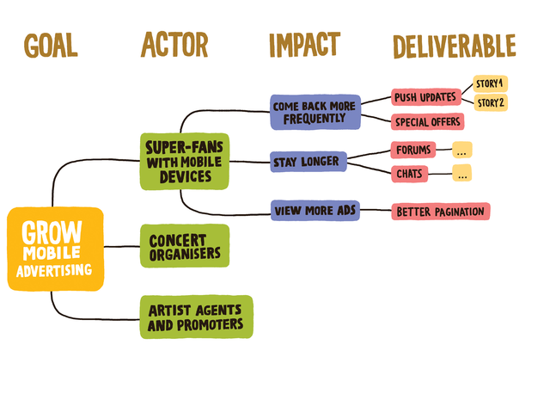
aLTERNATE tool – Impact Map
Instead of starting from the story (tasks), we can also start from the Goal:
https://www.impactmapping.org/fr/drawing.html

